Slide 1
Topic:
S.No | Team Member Name | Roll Number
1 | K Dharani Kumar | AM.SC.U4CSE24123
2 | K Bhanu Sai Raj | AM.SC.U4CSE24125
3 | M Surya Kiran | AM.SC.U4CSE24130
4 | Ayman Jasim M R | AM.SC.U4CSE24163

Slide 2
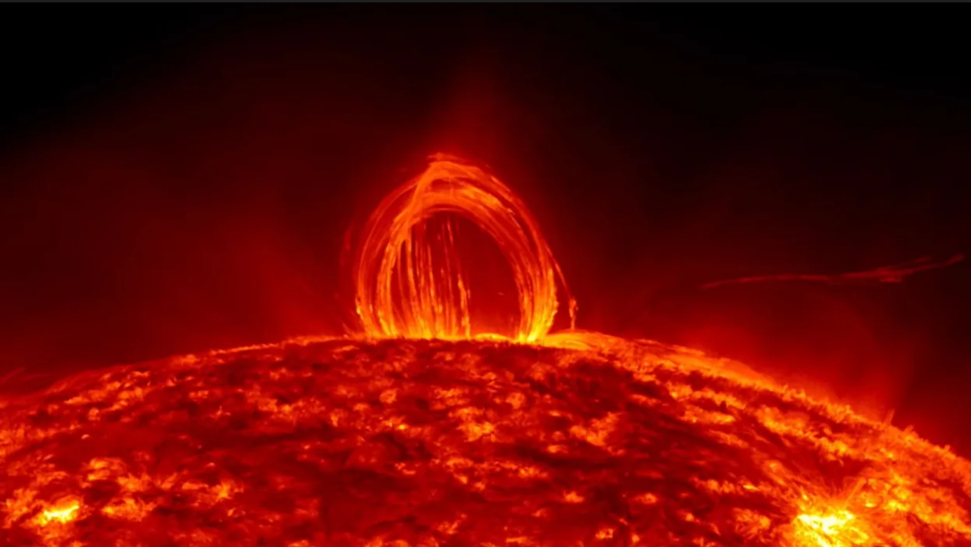
Introduction & Problem Statement
Solar Flares, Satellites, GPS & Communications – Why Forecasting Matters
Solar flares release intense X-rays and energetic particles.
They can affect satellites and onboard electronics.
They can disrupt GPS, navigation, and communication systems.
Early forecasting provides time to take protective actions.
Goal: Predict solar flares early and reduce the impact on space-based and communication systems.

Slide 3
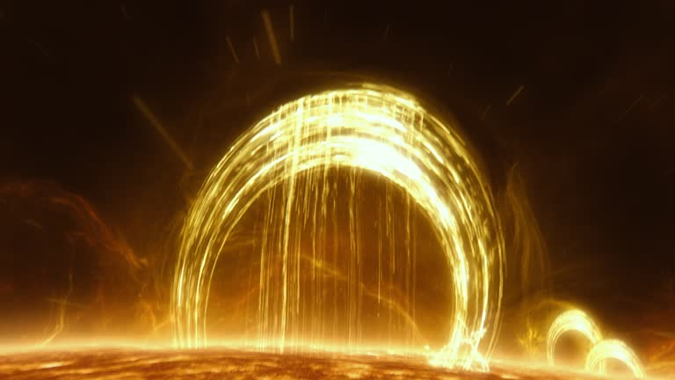
Literature Review – Solar Flare Forecasting
Existing Models: CNN, LSTM/BiLSTM, Attention and Transformers are widely used for flare prediction.
Common Datasets: GOES X-ray data and SDO/HMI observations are commonly used.
Key Finding: Temporal models generally perform better because solar flares evolve over time.
Research Gap: Limited research uses Aditya-L1 SoLEXS & HEL1OS, high-frequency X-ray data, and multi-instrument fusion.

Slide 4
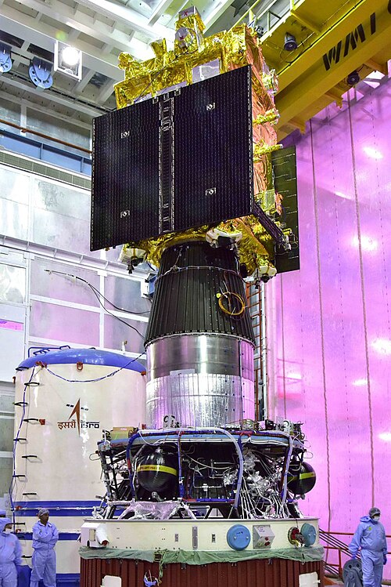
Aditya-L1 & Selected Payloads
Aditya-L1
India’s first dedicated solar observatory at the Sun–Earth L1 point, providing continuous solar observations.
SoLEXS
Measures soft X-rays (1–30 keV) to study thermal plasma heating during solar flares.
HEL1OS
Measures hard X-rays (10–150 keV) to study energetic electron activity during flares.

Slide 5
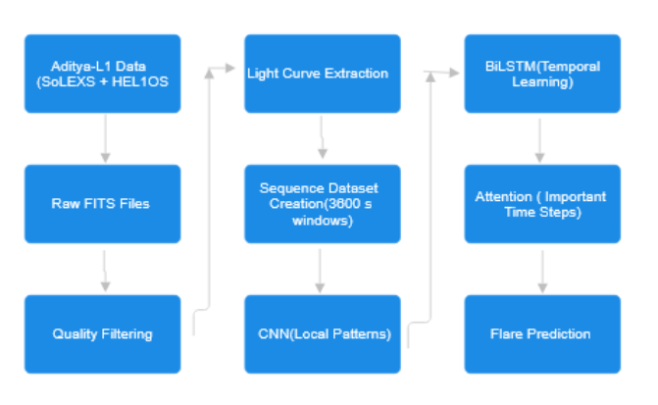
Proposed Methodology
Data Collection: Collect SoLEXS and HEL1OS X-ray data from Aditya-L1.
Preprocessing: Clean the data and create 3600-second light-curve sequences.
Feature Fusion: Combine thermal and non-thermal X-ray features.
Deep Learning: CNN → BiLSTM → Attention to learn spatial and temporal patterns.
Prediction: Classify the sequence as Flare or No-Flare.

Slide 6
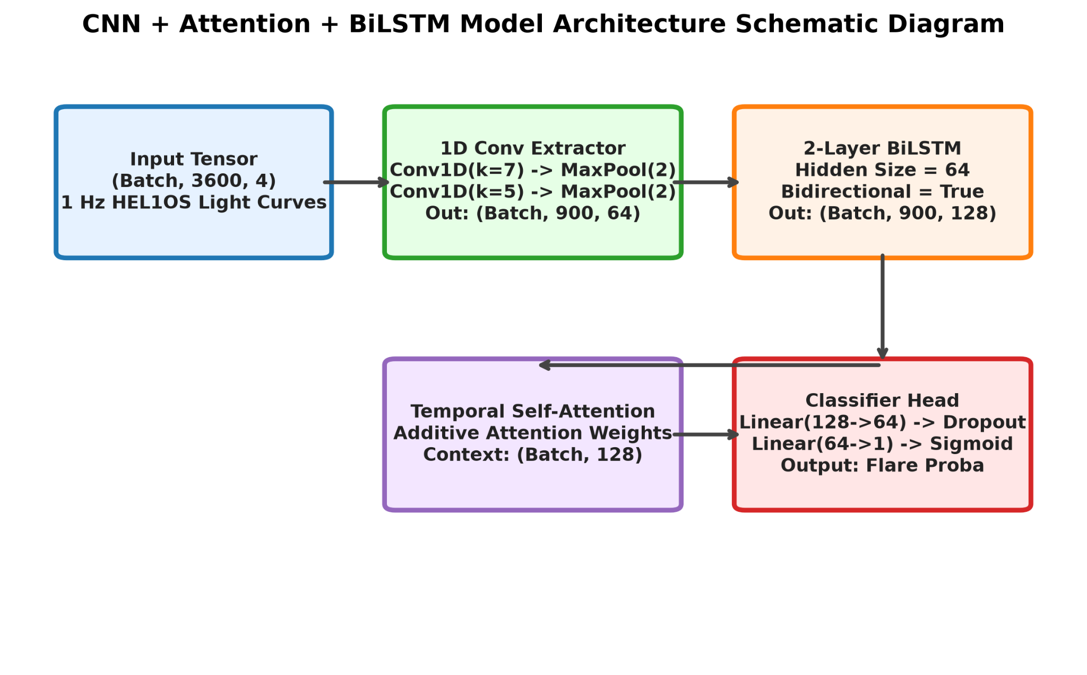

Slide 7
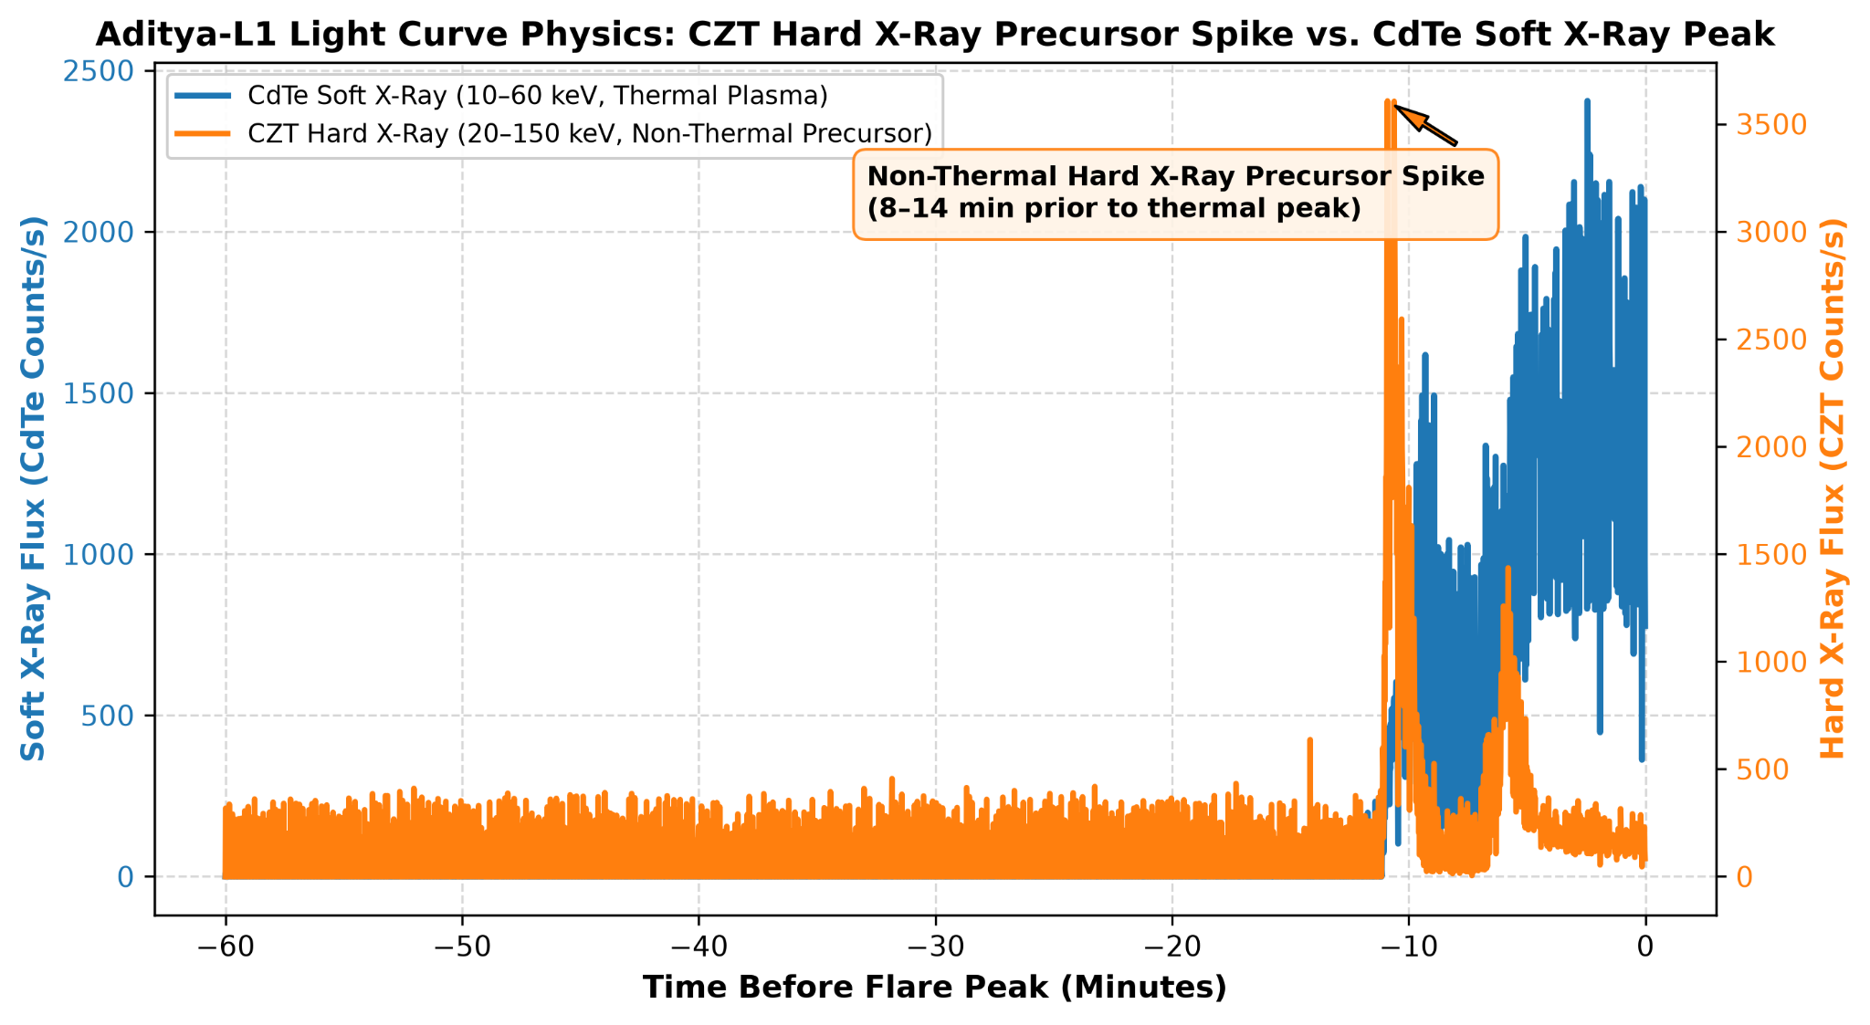
Dataset Creation & Statistics
Dataset Statistics
105 Observation Dates
4,491 Valid FITS Files
732 Final Sequences
60 min Lookback Window
Input Shape: (732, 3600, 4)
Input Data
732 samples × 3600 time steps × 4 channels
Final dataset: Clean, labeled X-ray sequences ready for deep-learning-based flare prediction

Slide 8
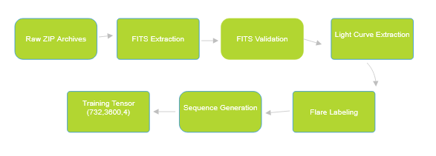
Data Processing Pipeline
Raw FITS: Collect satellite observation files.
Quality Filtering: Remove invalid or incomplete data.
Extraction: Convert FITS data into X-ray light curves.
Labelling: Assign Flare / No-Flare labels.
Sequence Generation: Create fixed 60-minute sequences.
Training Dataset: Generate model-ready data (732, 3600, 4).

Slide 9
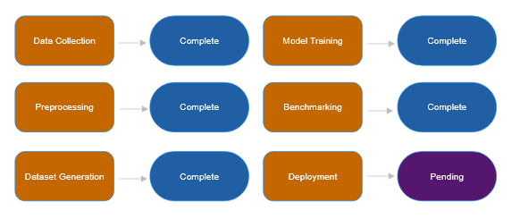
Implementation Progress

Slide 10
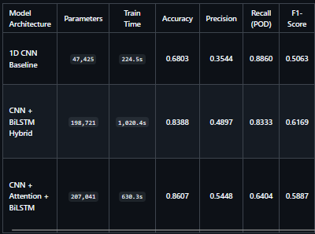
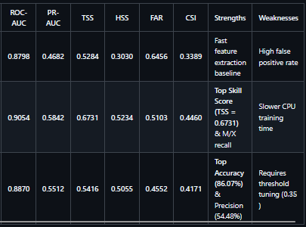
Results

Slide 11
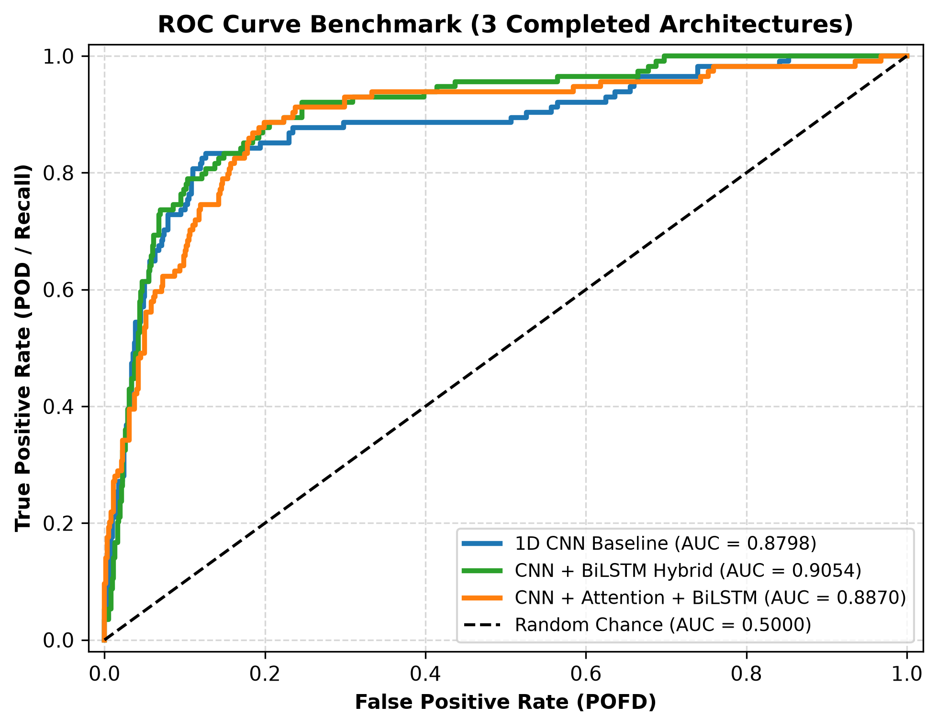
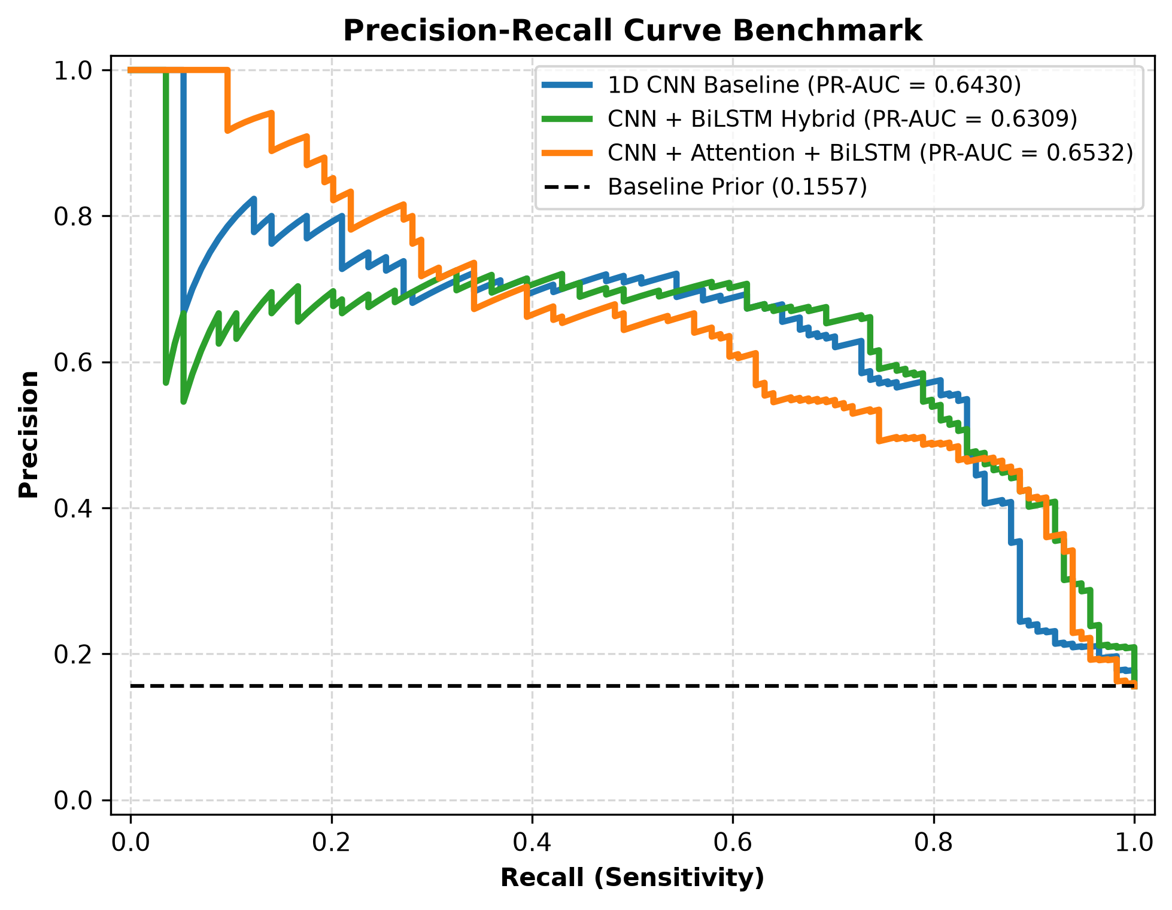
Results

Slide 12
Scientific Insights
Key Performance Insights & Gains
Substantial Major Flare Detection Boost: The model achieved an OOF Recall of 83.33%, successfully predicting 95 out of 114 major flares up to 60 minutes prior to peak flux.
Impact of Tier-1 Ingestion: Ingesting +36 additional M/X flares from Tier-1 dates expanded major flare training samples from 78 to 114, providing the network with diverse high-flux pre-flare dynamics.
Sequential Feature Extraction: The 2-layer Bidirectional LSTM backbone captured long-range temporal trends and derivative shifts across the 3,600s window that static CNN pooling missed.

Slide 13
Challenges & Phase 2 Plan
Challenges Faced
Limited Aditya-L1 data available
Imbalanced dataset
High training time for deep learning models
Future Work
Use magnetogram data for better accuracy
Develop a real-time forecasting system
Train on a larger Aditya-L1 dataset

Slide 14
Conclusion & References
[1] Indian Space Research Organisation (ISRO), "Aditya-L1 Mission," ISRO. [Online]. Available: https://www.isro.gov.in/Aditya_L1.html. [Accessed: Sep. 4, 2026
[2] National Aeronautics and Space Administration (NASA), "Solar Dynamics Observatory," NASA. [Online]. Available: https://sdo.gsfc.nasa.gov/. [Accessed: Sep. 4, 2026].
[3] National Oceanic and Atmospheric Administration (NOAA), "Space Weather Prediction Center," NOAA. [Online]. Available: https://www.swpc.noaa.gov/. [Accessed: Sep. 4, 2026].
[4] TensorFlow Developers, "TensorFlow Documentation." [Online]. Available: https://www.tensorflow.org/. [Accessed: Sep. 4, 2026].
[5] Scikit-learn Developers, "Scikit-learn: Machine Learning in Python." [Online]. Available: https://scikit-learn.org/. [Accessed: Sep. 4, 2026].

